Slide 1
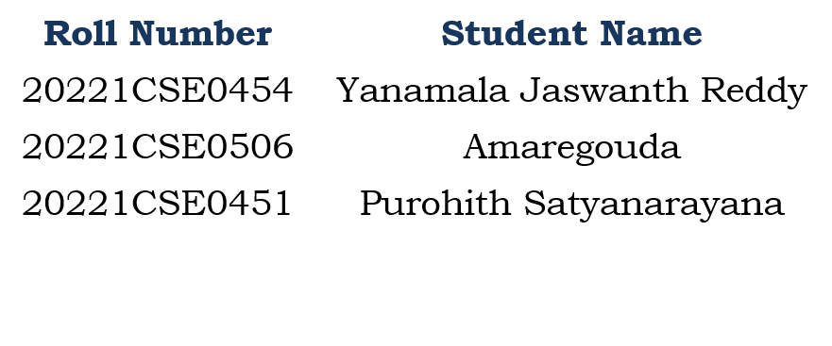
Development of a Digital Farm Management Portal for implementing Biosecurity measures in Pig and Poultry Farms
CSE7302- University Project
Review-5
Batch Number: CSE_100
Under the Supervision of,
Mr. Venkatesan D
Assistant Professor
School of Computer Science and Engineering
Presidency University
Name of the Program : CSE
Name of the HOD: Dr. Blessed Prince
Name of the Program Project Coordinator: Mr. Muthuraju V
Name of the School Project Coordinators: Dr. Sampath A K

Slide 2
Problem Statement Number : SIH25006
Organization:
Category (Hardware / Software / Both) : Software
Problem Description:
There is an urgent need for a user-friendly, digital platform that empowers farmers to Implement monitor, and sustain robust biosecurity practices on their farms.
Customizable risk assessment tools based on local epidemiological conditions.
Interactive training modules and best practice guidelines tailored for pig and poultry production systems.
Compliance tracking features aligned with regulatory frameworks to help farmers work toward disease-free compartment recognition.
Real-time alerts and monitoring dashboards for disease outbreaks and biosecurity breaches.
Multilingual and mobile-first design to ensure accessibility in remote and rural areas.

Slide 3
Content
Abstract
Literature Survey
Objectives
Existing Methods and Drawbacks
Proposed Method & Feasibility Study
Modules
Hardware and Software Details
Timeline (Gantt Chart)
References

Slide 4
Abstract :
Biosecurity is essential in pig and poultry farming to prevent disease outbreaks and ensure healthy livestock production.
Currently, many farms rely on manual record-keeping systems, which are inefficient and prone to errors.
The objective of this project is to develop a centralized digital portal that integrates animal health records, vaccination schedules, visitor tracking, sanitation monitoring, and feed inventory management.
The system supports automated reminders, digital reports, and real-time monitoring to improve farm safety and efficiency.
The solution bridges the gap between traditional farming practices and modern digital farm management systems.

Slide 5
Literature Survey (Overview):
Databases searched: IEEE Xplore, Scopus, Google Scholar, Web of Science
Keywords: biosecurity in livestock farms, digital farm management, poultry health monitoring, pig disease prevention, livestock management systems
Reviewed 25+ papers, shortlisted 10 relevant works from 2010–2023.
Key Themes:
Livestock management information systems
Disease prevention frameworks in poultry and pig farms
Vaccination management systems
Biosecurity compliance monitoring
Observation:
Most systems focus on general livestock management ,but do not provide a complete biosecurity-focused integrated portal.
Gap Identified:
Lack of a centralized, scalable, and user-friendly digital system specifically designed for implementing biosecurity measures in pig and poultry farms.

Slide 6
Literature Summary Table :
Sl. No. | Paper (Year) | Problem Studied | Approach | Findings | Gap Identified
1 | IEEE (2020) – Smart Livestock Monitoring | Animal health monitoring in farms | IoT sensors for temperature & movement tracking | Real-time health tracking improves early disease detection | No integrated biosecurity management system
2 | Elsevier (2021) – Poultry Disease Detection | Early detection of poultry diseases | Machine Learning classification models | Improved prediction accuracy | No vaccination or farm management module
3 | MDPI (2022) – Biosecurity Risk Assessment | Disease outbreak risk in pig farms | Risk analysis framework | Reduced disease spread with preventive measures | Manual tracking, no digital portal
4 | IEEE Access (2019) – Smart Farm Systems | Automation in livestock farms | IoT + Cloud computing | Increased productivity and monitoring | High implementation cost
5 | FAO Guidelines (2018) – Farm Biosecurity | Biosecurity standards for livestock farms | Preventive protocols & guidelines | Clear hygiene & control measures | No digital implementation support
6 | IEEE IoT Journal (2020) – Sensor-Based Livestock Monitoring | Real-time livestock tracking | Wearable sensors + Cloud dashboards | Improved monitoring efficiency | Focused only on tracking, not full management
7 | Springer (2017) – Farm Management Information Systems | Digital farm record management | Database-driven farm systems | Improved documentation | No biosecurity enforcement features
8 | IEEE (2021) – Disease Surveillance Systems | Disease outbreak detection | Data analytics & anomaly detection | Early outbreak alerts possible | Limited to health data only
9 | Elsevier (2020) – Precision Poultry Farming | Poultry productivity improvement | Data-driven decision systems | Increased egg/meat yield | No visitor or sanitation tracking
10 | WHO (2022) – Zoonotic Disease Prevention | Preventing animal-to-human disease spread | Hygiene & vaccination frameworks | Strong prevention strategies | No integrated farm-level monitoring system

Slide 7
Objectives :
Data Integration :
Collect and unify farm data including health records, vaccination schedules, and visitor logs.
Biosecurity Monitoring :
Track sanitation measures and farm entry restrictions.
Automation :
Enable automatic vaccination reminders and alert notifications.
Health Management :
Maintain animal-wise health records and mortality reports.
Reporting :
Generate PDF/Excel reports for farm owners and regulatory authorities.
Accessibility :
Provide role-based access (Admin, Farm Manager, Worker).
Scalability :
Design modular architecture to support multiple farms and future IoT integration.

Slide 8
Existing Methods & Drawbacks :
Manual Record Keeping System :
Description: Most pig and poultry farms maintain records in physical registers. Health status, vaccination schedules, mortality data, visitor entries, and feed consumption are written manually.
Strengths:
Very low cost
Easy to implement
No technical knowledge required
Drawbacks:
High risk of data loss or damage
Human errors in recording data
No automated reminders for vaccination
Difficult to track disease history
No data analytics or trend monitoring

Slide 9
2. Excel-Based Farm Tracking :
Description: Some medium-scale farms use Excel sheets to maintain digital records of livestock, vaccination, and feed inventory.
Strengths:
Better than manual registers
Data can be stored digitally
Basic calculations possible
Drawbacks:
Not centralized (multiple sheets for different tasks)
No real-time alert system
No proper biosecurity monitoring
Limited scalability for large farms
Requires manual updates
No role-based access control

Slide 10
Proposed Method :
Data Collection:
Farm data entered through secure login portal.
Data Storage:
MySQL/PostgreSQL database for structured storage.
Processing:
Backend logic using Java (Servlet/JSP) or Flask for business rules.
Visualization:
React.js dashboard with charts and alerts.
Reporting:
Export reports in PDF/Excel format.
Security:
Role-based authentication and data encryption.
Scalability:
Easily scalable for future expansion.

Slide 11
Feasibility Study :
Technical Feasibility:
Uses proven technologies (React, Java, MySQL).
Operational Feasibility:
Simple user interface suitable for farm workers.
Economic Feasibility:
Open-source stack → low development and maintenance cost.
Resource Feasibility:
3-member team with division into frontend, backend, database, and documentation.
Scalability Feasibility:
Designed to support future growth, users, and features seamlessly.

Slide 12
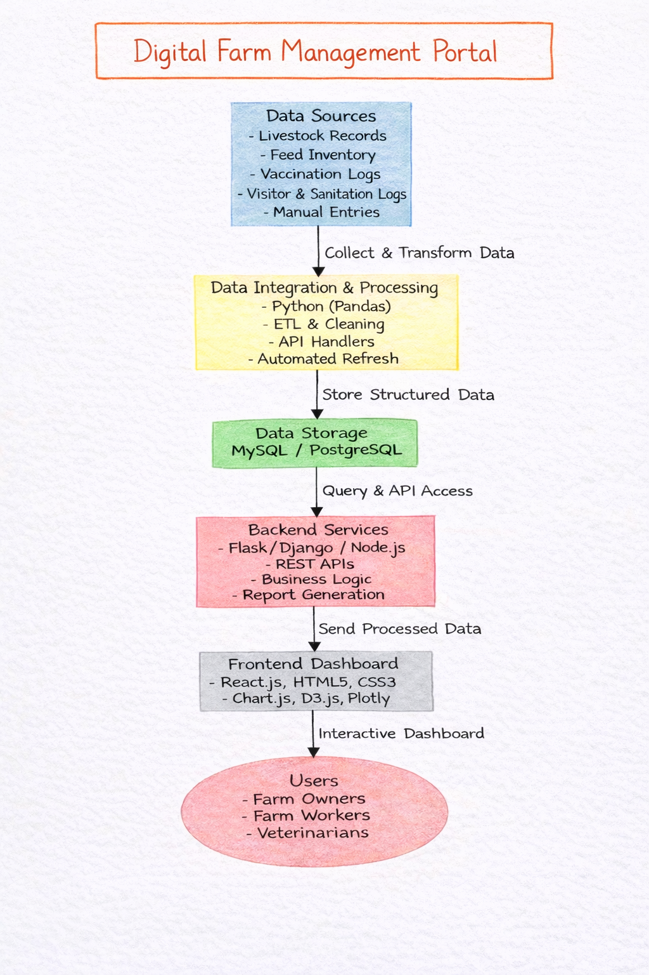
Architecture Diagram & Explanation :
Flow: Data → Process → Store → Backend → Dashboard → Users
Data Sources: Collects farm information.
Processing: Cleans and organizes data.
Storage: Saves data in database.
Backend: Handles logic and APIs.
Frontend: Shows dashboard and reports.
Users: Access and manage farm data.

Slide 13
Modules :
User Management Module: Manages user login, registration, and role-based access control.
Animal Health Management Module: Stores and tracks animal health records, treatments, and mortality data.
Vaccination Management Module: Schedules vaccinations and sends reminders to prevent diseases.
Biosecurity Monitoring Module: Records visitor logs and sanitation activities to maintain farm safety.
Feed & Inventory Management Module: Tracks feed and medicine stock with low-stock alerts.
Reporting & Analytics Module: Generates reports and dashboards for better decision-making.
Security & Backup Module: Protects data through secure access and regular backups.

Slide 14
Technology Stack(Hardware and Software Details) :
Layer | Technology | Purpose | Why Chosen | Role in Project
Frontend | React.js | UI | Fast & Modular | Dashboard Interface
Backend | Java (JSP/Servlet) | Business Logic | Reliable | API & Processing
Database | MySQL | Data Storage | Scalable | Farm Data Repository
Analytics | Python (Pandas) | Data Analysis | Efficient | Trend & Risk Analysis
Server | Apache Tomcat | Deployment | Open-source | Web Hosting

Slide 15
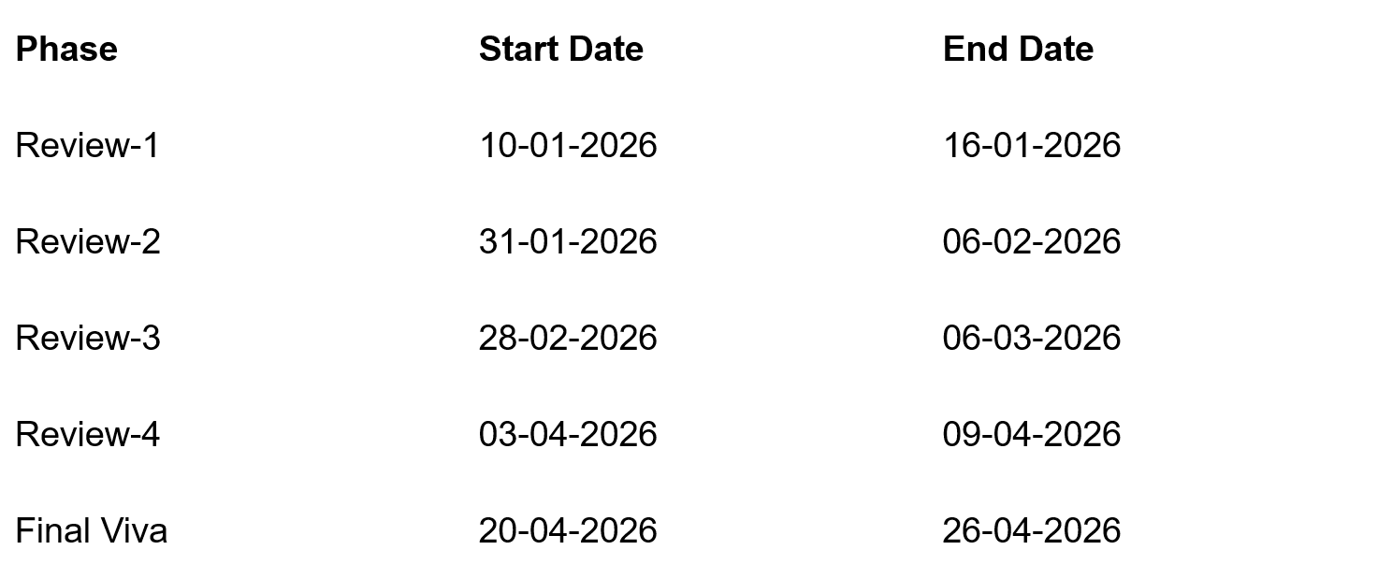
Timeline of the Project (Gantt Chart)

Slide 16
Academic References (IEEE/Scopus/Web of Science) :
T. Köhne et al., “Design and Evaluation of a Livestock Farm Management System,” IEEE Access, 2021.
L. Wang and X. Li, “Smart Livestock Monitoring Using IoT and Cloud Computing,” Sensors, 2020.
F. Zhang, M. Hasan, “Precision Poultry Farming: A Review,” Computers and Electronics in Agriculture, 2019.
J. Smith et al., “Biosecurity Strategies for Livestock Disease Prevention,” Journal of Animal Science, 2020.
FAO, “Biosecurity in Animal Production and Veterinary Public Health,” FAO Animal Health Manual, 2018.
T. Nguyen and H. Kim, “Automated Livestock Health Tracking System Using Wearable Sensors,” IEEE Internet of Things Journal, 2020.
R. Singh and S. Sharma, “A Farm ERP — Integrated Information System for Livestock Farms,” International Journal of Agricultural Management, 2019.
P. Kumar and A. Gupta, “Disease Detection in Poultry Farms Using Machine Learning,” Elsevier Computing in Agriculture, 2021.
H. Al-Amin et al., “Cloud-Based Farm Management Systems: Architecture and Case Study,” Journal of Network and Computer Applications, 2022.
B. Patel and R. Patel, “Livestock Vaccination Scheduling and Alert System,” International Journal of Biological Engineering, 2019.

Slide 17
S. Rao and P. Reddy, “Monitoring Farm Biosecurity Using Mobile Information Systems,” Journal of Mobile Computing and Applications, 2021.
M. R. Islam et al., “Database Design for Livestock Management Systems,” ACM Transactions on Database Systems, 2018.
L. D. Truong et al., “Farm Management Information Systems: Adoption and Challenges,” Journal of Rural Studies, 2019.
C. Zhao and Y. Shen, “Decision Support Systems for Livestock Disease Control,” Expert Systems with Applications, 2020.
P. Singh et al., “Evaluating Farm-Level Biosecurity Practices in Poultry Production,” Preventive Veterinary Medicine, 2021.
G. Johnson and T. Clark, “Architecture for Scalable Agricultural Data Systems,” IEEE Transactions on Cloud Computing, 2022.
K. Brown et al., “Impact of Digital Farm Tools in Smallholder Productivity,” Agricultural Systems, 2020.
J. Lee and D. Kim, “Web-Based Information Systems for Livestock Management,” International Journal of Web Engineering, 2018.
R. Dasgupta and S. Pal, “Review of Smart Farming and Animal Tracking,” Computers in Agriculture and Food Research, 2021.
WHO, “Guidelines for Zoonotic Disease Prevention in Animal-Human Interfaces,” World Health Organization, 2022.

Slide 18
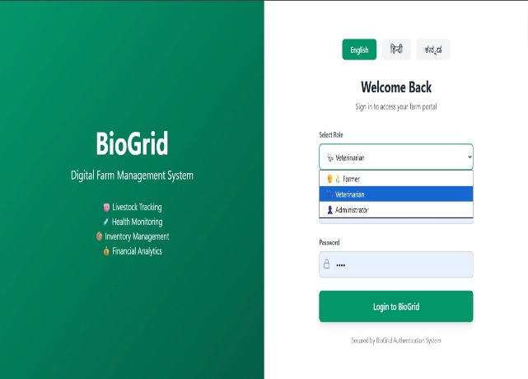
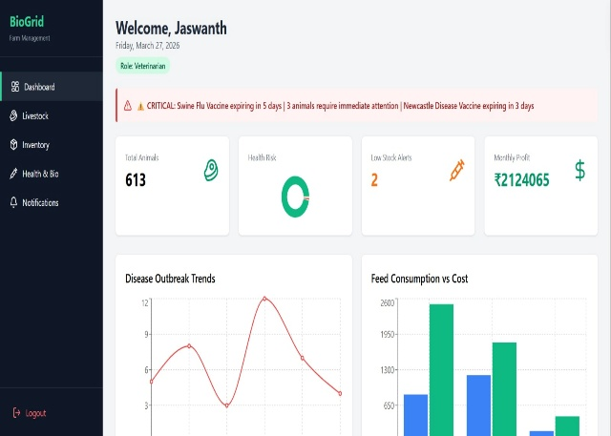
Few Output Images:
Fig 1(Login & Registration Page) Fig 2(Overall Dashboard)

Slide 19
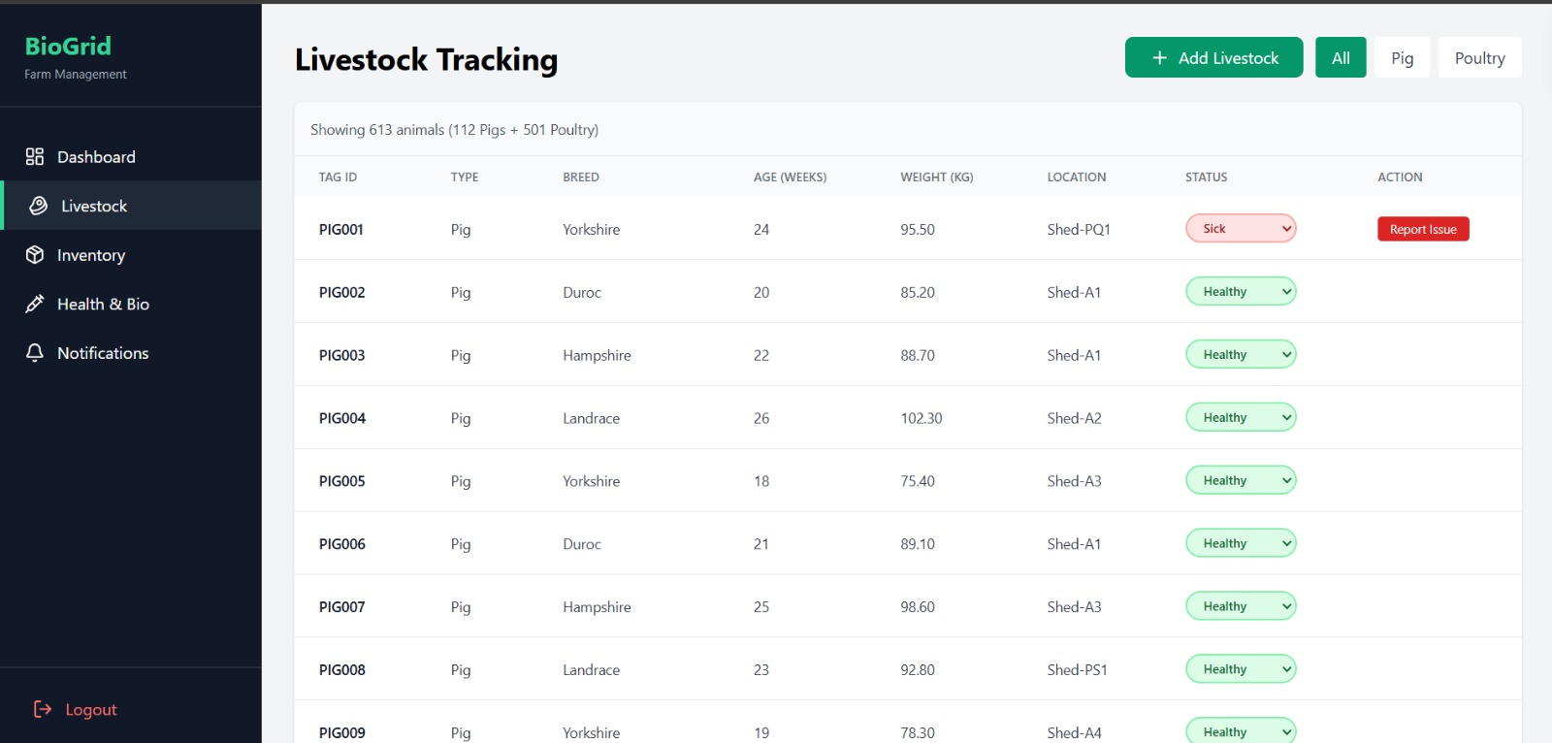
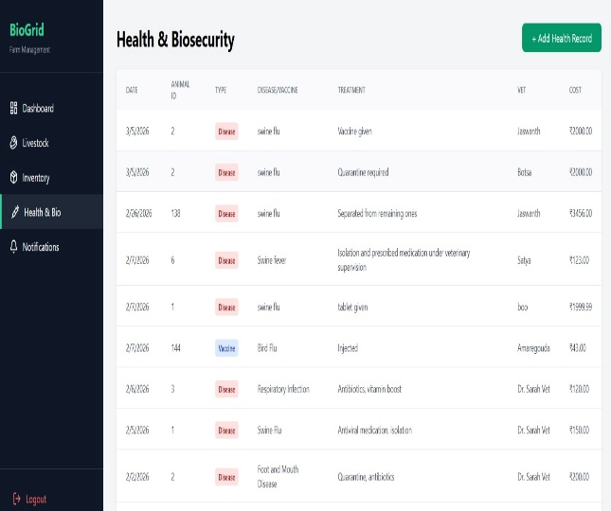
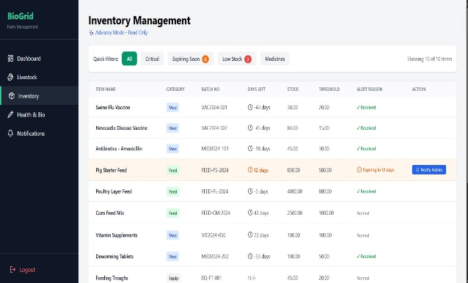
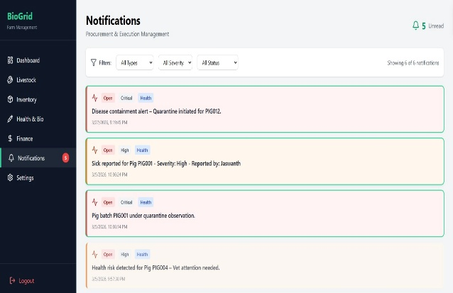
Fig 3(Livestock Tracking) Fig 4(Health & Biosecurity)
Fig 5(Inventory Management) Fig 6(Notifications)

Slide 20
Github Link
The Github link provided should have public access permission.
Github Link
https://github.com/jaswanthyanamala-coder/Digital-Farm-Management-Portal

Slide 21


